Slide 1


Cross compiler development in compiler design
Course Faculty:
Dr. N. Michael
Done by:
M Ganga Dinesh Reddy(192211451),
Mohamed Bayaz. A(192224007),
V Praveen(192221006)

Slide 2
OBJECTIVE
Cross-compilation is the process of developing code on one machine (the host) to run on another machine (the target). A cross-compiler, capable of creating executable code for a different platform, facilitates this. Developers benefit from cross-compilation in several ways: portability across diverse environments, time-saving due to faster host machines, cost-effectiveness by avoiding multiple physical devices, and flexibility for resource-constrained platforms.

Slide 3
INTRODUCTION
Cross-compilation involves compiling code on one system (the host) to create executable code that can run on a different system (the target). A cross-compiler, capable of generating code for a platform other than its own, facilitates this process. For instance, a cross-compiler running on a PC can produce code for an embedded device or a different architecture. Developers use cross-compilers for several reasons: portability across diverse environments, faster development on powerful host machines, cost-effectiveness, and flexibility for resource-constrained platforms. These essential tools enable software development for new platforms, microcontrollers, and embedded systems. The project you’re working on aims to create a cross-compiler that compiles code on a host machine and generates executable code for a different target platform.

Slide 4
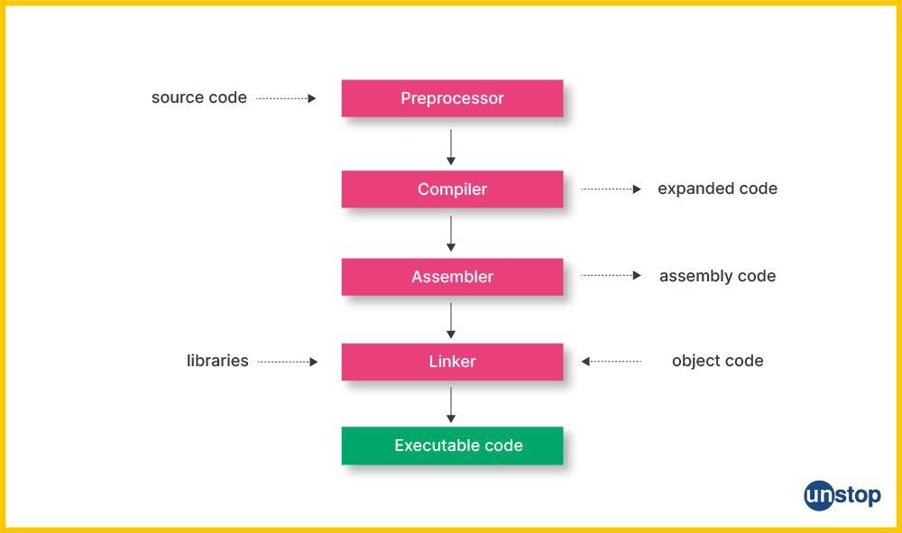
ARCHITECTURE

Slide 5
IMPLEMENTATION
Set Up the Environment:
Create a directory for your project
Download and Extract Binutils and GCC:
Download the source code for Binutils and GCC from their official websites or mirrors.
Extract the downloaded files:
Build and Install Binutils:
Create a build directory for Binutils:
Configure and build BinutilS
Build and Install GCC:
Create a build directory for GCC:
Configure and build GCC:
Set Environment Variables:
Add the cross-compiler to your PATH:
Test the Cross-Compiler:
Create a simple C program to test the cross-compiler:
Compile the program using the cross-compiler:

Slide 6
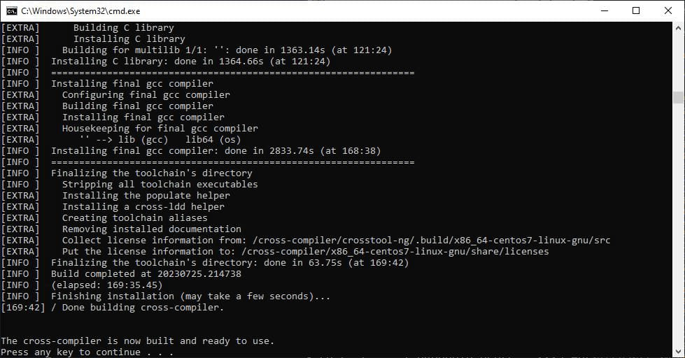
OUTPUT

Slide 7
CONCLUSION
In conclusion, the development of a cross-compiler is a significant undertaking that serves a vital role in the realm of software engineering, particularly in the embedded systems and microcontroller domains. The project’s success lies in its ability to allow developers to compile code on a host machine for execution on a different target platform, bridging the gap between various computing environments. This facilitates the creation of software that is not only portable but also optimized for performance on target systems with different architectures or limited resources. The cross-compiler toolchain, once established, becomes an indispensable asset for developers, enabling them to efficiently produce robust and scalable applications across diverse hardware platforms.

Slide 8



